Slide 1
Lecture 14
Java I/O class-Stream Classes & File manipulation in Java

Slide 2
Relationship of Java Program with I/O Devices
Keyboard
Screen
Java
Program
Mouse
Printer
Memory
Memory
Disk
Disk
Network
Network

Slide 3
Streams
Java program performs I/O through streams.
Stream is an abstraction that hides the details of the physical devices which are involved in I/O operation.
A stream is linked to a physical device by the java I/O system.
In java objects are used to represent streams of data
In a program, we read information from an input stream and write information to an output stream

Slide 4


Streams
A uniform, easy-to-use, object-oriented interface between the program and the input/output devices.
A stream represent an ordered sequence of data.

Slide 5
Stream
A stream can be thought as a path along which data flows.
It has a source and a destination.

Slide 6
Input and Output Streams
Input Stream
Source
reads
Program
(a) Reading data into a program
Output Stream
Program
write
Destination
(a) Writing data to a destination

Slide 7
Java idioms
Writing
open a stream
while(more information)
write information to stream
close the stream
Reading
open a stream
while(more information)
read information from stream
close the stream
Notes:
Regardless of the type of data you are dealing with and the direction in which it is going, the concept is basically the same.
Read slide.

Slide 8
The Predefined Stream
java.lang contains a class named System.
System contains 3 predefined stream variables: in, out and err. They are declared public and static.
System.in- standard input stream.
- an object of type InputStream
System.out- standard output stream
-an object of type PrintStream.
System.err- standard error stream
- an object of type PrintStream.

Slide 9
I/O Stream
The java.io package contains many classes that allow us to define various streams with particular characteristics
Two types of I/O streams:
-byte streams and –character streams.

Slide 10
Byte Stream:
Used to handle input and output of bytes.
Used when reading and writing binary data.
Character Stream:
Used to handle input and output of characters.
Use unicode and can be internationalized.

Slide 11
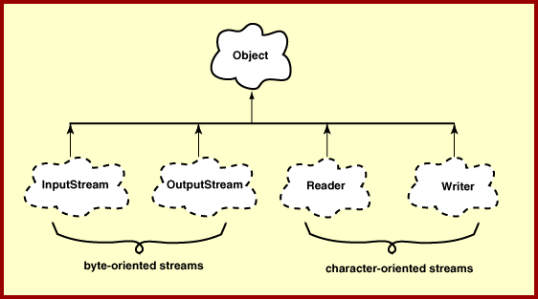
Top I/O Hierarchy

Slide 12
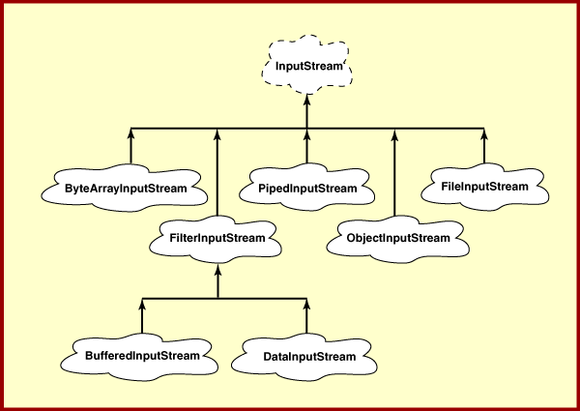
InputStream (Byte Stream)

Slide 13
InputStream
Is an abstract class.
It implements the Closeable interface.
All the methods throw an IOException on error condition.
Closeable Interface:
Belongs to java.io.
Objects of a class that implements Closeable can be closed.
It defines:
void close() throws IOException

Slide 14
Methods Defined by InputStream
read() ------- Reads a byte from the input stream and return integer representation
read (byte b[])------Reads an array of bytes into b
read ( byte b[], int n, int m)---Reads m bytes into b starting from nth byte.
available()------ gives number of bytes available in the input
skip(long n)-------Skips over n bytes from the input stream.
mark(int m)--- places a mark at the current position in the input stream that will remain valid until m bytes are read.
reset()-----resets the input pointer to the previously set mark,
close()---- Closes the input stream.
Note:
All the methods except mark() and reset() methods are implemented by the subclasses of InputStream.

Slide 15
Reader
An abstract class.
Implements Closeable and Readable interface.
Readable Interface:
Indicates an object that can be used as a source for characters.
It defines:
int read(charBuffer buf)
reads characters into buf. It returns the number of characters read or -1 if an EOF is encountered.
Belongs to java.nio

Slide 16
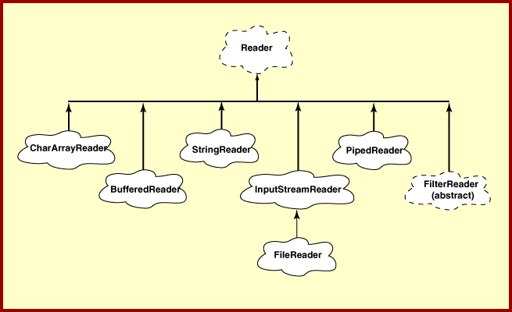
Reader (Character Stream)

Slide 17
Methods Defined by Reader
read() ------- Reads a character from the stream and return integer representation
read (char b[])------Reads an array of characters into b
read ( char b[], int n, int m)---Reads m characters into b starting from nth position.
skip(long n)-------Skips over n characters from the input stream.
mark(int m)--- places a mark at the current position in the input stream that will remain valid until m characters are read.
reset()-----resets the input pointer to the previously set mark,
close()---- Closes the input stream.
Note:
All the methods throw IOException on error condition.

Slide 18
InputStreamReader
Super class: Reader
Connects to an underlying InputStream
Translates bytes from InputStream into characters
It reads bytes and decodes them into characters.
Notes:
We want some functionality in our input stream, we want to be able to read a string of characters and do some processing with them. so we use an input stream reader, a subclass of reader to convert the bytes read from the input stream to characters. Each read operation may cause more than one read on the underlying stream. Which could be inefficient so

Slide 19
BufferedReader
Super class: Reader
Connects to an underlying reader (often an InputStreamReader or FileReader)
Associates memory space with a stream(input or output)
It implements mark() and reset().
Speed up the I/O operation.
Notes:
We wrap the InputStreamReader in a BufferedReader which also subclasses reader for extra efficiency . This means that instead of reading every single character individually characters can be read into a buffer. The class offers a default buffer, or you can specify the size.

Slide 20
Reading Console Input
BufferedReader in =
new BufferedReader(new InputStreamReader(System.in));
InputStreamReader(InputStream in);
InputStreamReader converts the byte input stream to a character input stream.
BufferedReader supports a buffered stream.
BufferedReader(Reader in)
Reader
InputStreamReader

Slide 21

InputStreamReader
BufferedReader stdin = new BufferedReader (
new InputStreamReader ( System.in ) );
System.in is an object of InputStream
Notes:
Wrapping of stream objects

Slide 22
Reading Characters:
int read( ) throws IOException
- it reads a character from the input stream and returns it as integer value.
- It returns -1 when the end of the stream is encountered.
Reading Strings:
String readLine() throws IOException
Member of BufferedReader.

Slide 23
Example- Reading String from the Keyboard
import java.io.*;
class java_io
{
public static void main(String arags[]) throws IOException
{
String str;
BufferedReader br = new BufferedReader(new InputStreamReader(System.in));
System.out.println("Enter input:");
do
{
str=br.readLine();
System.out.println(str);
}while(!str.equals("stop"));
}
}

Slide 24
Example- Java Program to Calculate the Sum of a List of Numbers
import java.io.*;
class in_f
{
public static void main(String args[]) throws IOException
{
BufferedReader br = new BufferedReader(new InputStreamReader(System.in));
String str;
int sum=0;
int num;
while(true)
{
str=br.readLine();
num=Integer.parseInt(str);
if(num!=-1)
sum=sum+num;
else
break;
}
System.out.println("sum: "+sum);
}
}

Slide 25
OutputStream (Byte Stream)
An Abstract class.
It implements Closeable and Flushable interface.
All the methods in this class return void and throw an IOException in the case of errors.
Flushable Interface:
It defines:
void flush() throws IOException
Flushing a stream typically causes buffered output to be physically written to the underlying device

Slide 26
Methods Defined by OutputStream
void close()--- closes the output stream.
void flush()--- it flushes the output buffers.
void write( int b) --- writes a single byte to an output stream.
void write ( byte buff[]) --- writes a complete array of bytes to an output stream.
void write ( byte buff[], int offset, int numbytes) --- writes the numbytes bytes from the array buff beginning at buff [offset].

Slide 27
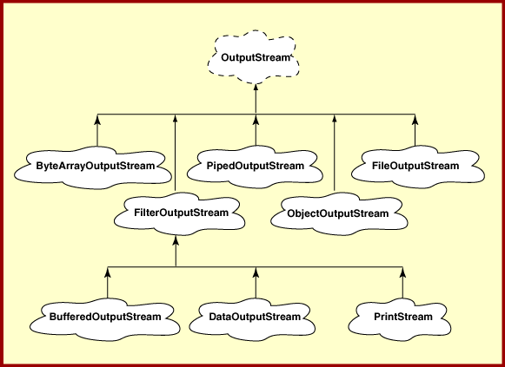
Output Stream (Output Stream)

Slide 28
Writer (Character Output Stream)
An abstract class.
Implements Closeable, Flushable and Appendable interfaces.
Appendable Interface:
Belongs to java.lang.
Objects of a class that implements Appendable can have a character or character sequences appended to it.
It defines;
1. Appendable append(char ch) throws IOException
2. Appendable append(CharSequence chars) throws IOException
3. Appendable append(CharSequence chars, int begin, int end) throws IOException

Slide 29
Useful Methods of Writer
void close()--- closes the output stream.
void flush()--- it flushes the output buffers.
void write( int b) --- writes a single character to an output stream.
void write ( char buff[]) --- writes a complete array of characters to an output stream.
void write ( char buff[], int offset, int numbytes) --- writes the numbytes characters from the array buff beginning at buff [offset].
void write (String str)--- Writes str to the invoking output stream.
Writer append (char ch)– Appends ch to the end of the output stream
Writer append (CharSequence ch)– Appends ch to the end of the output stream.

Slide 30
File Class
Belongs to java.io.
It is used to obtain or manipulate the information associated with a disk file.
A directory in java is treated simply as a File object with one additional property- a list of file name can be examined by the list() method.

Slide 31
Constructors of File Class
File (String directoryPath)
Example:
File f1 = new File(“/java”);
File (String directoryPath, String filename)
Example:
File f2 = new File(“/java”, “image.java”);
File (File dirObj, String filename)
Example:
File f3 = new File(f1, “image.java”);

Slide 32
Example: Obtaining Standard Properties of a File Object
import java.io.*;
class file_tst
{
public static void main(String args[])
{
File f1 = new File(“/tmp/test");
System.out.println("file name: "+f1.getName());
System.out.println("file exist: "+f1.exists());
System.out.println("path: "+f1.getPath());
System.out.println("parent: "+f1.getParent());
System.out.println(f1.canWrite() ? "is writeable" : "is not writeable");
System.out.println(f1.canRead() ? "is readable" : "is not readable");
System.out.println(f1.isDirectory() ? "is a directory" : "is not a directory");
System.out.println("file size: "+f1.length()+" bytes");
}
}

Slide 33
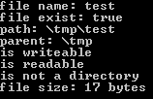
Output

Slide 34
Listing a Directory
public void lst_dir(String d_Name)
{
File d_List = new File(d_Name);
String[] lst = d_List.list();
for(int i = 0; i < lst.length; i++)
System.out.println(lst[i]);
}
String[] list : Returns an array of strings naming the files and directories in the
directory denoted by this abstract pathname.

Slide 35
Reader (Character Stream)

Slide 36
FileReader
This class creates a Reader that can be used to read the contents of a file.
1. public FileReader(File file)
throws FileNotFoundException
Creates a new FileReader, given the File to read from
2. public FileReader(String fileName)
throws FileNotFoundException
Creates a new FileReader, given the name of the file to read from
Note:
FileNotFoundException is a checked exception.
Notes:
So in order to read from a file, we use a subclass of InputStreamReader, called fileReader,
This class offers 3 constructors:
one of which takes an object of type file,
one of which takes a file descriptor, that is a handle to an underlying file,
and the last which takes a string, representing a filename. You will most likely be interested in the string version.
No new methods in that class

Slide 37
Useful methods (Inherited from Reader)
public int read() throws IOException
  Returns an integer representation of the next available character. Returns -1 when the end of the file is encountered.
  Int read(char[] cbuf)
  Read characters into an array. Cbuf is the destination buffer. Return the number of characters read, or –1 when the end of the file is reached.
int read(char[] cbuf, int off, int len)
Attempts to read upto len characters into the cbuf starting at cbuf[off], returning the number of characters successfully read.-1 when the end of file is encountered.

Slide 38
Useful Methods (Inherited from Reader)
void close()
Close the stream.
void mark(int numChars)
Mark the present position in the stream that will remain valid until numChars characters re read.
void reset()
Reset the stream. If the stream has been marked, then attempt to reposition it at the mark.
long skip(long n)
Skip characters. n is the number of characters to skip

Slide 39
Example-Reading Data from a File
import java.io.*;
class fl_read
{
public static void main(String args[]) throws IOException
{
FileReader fr = new FileReader("c:\\test.txt");
BufferedReader br = new BufferedReader(fr);
String str;
while((str=br.readLine())!=null)
System.out.println(str);
fr.close();
}
}

Slide 40
FileWriter
Class for writing character files
class FileWriter
extends Writer
Constructors:
FileWriter (File fp)
Constructs a FileWriter object given a File object.
FileWriter(File fp, boolean append)
Constructs a FileWriter object given a File object. If the boolean is true, then bytes will be written to the end of the file rather than the beginning.
Notes:
In order to write into a file, we use a subclass of Output Stream Writer, called FileWriter.
This class offers 5 constructors:
- READ THE SLIDE

Slide 41
FileWriter-Constructors
FileWriter(String fileName)
Constructs a FileWriter object given a file name.
FileWriter (String fileName, boolean append)
Constructs a FileWriter object given a file name with a boolean indicating whether or not to append the data written. If boolean is true, then the data will be written to the end of the file rather than the beginning
Notes:
READ THE SLIDE

Slide 42
FileWriter Methods
(Inherited from Writer)
Same methods as those in Writer class.
Notes:
READ THE SLIDE
(The parameters are the thing to be written in the FileWriter)

Slide 43
Example-Writing Data into a File
import java.io.*;
class f_wt1
{
public static void main(String args[]) throws IOException
{
FileWriter fw=new FileWriter("c:\\tmp12.txt",true);
BufferedReader in=new BufferedReader(new InputStreamReader(System.in));
char buf;
while(true)
{
buf=(char)in.read();
if(buf=='0')
break;
else
{
fw.write(buf);
}
}
in.close();
fw.close();
}
}

Slide 44
Output
Input from the keyboard:
1
2
3
0
Content of c:\tmp12.txt
1
2
3
0

Slide 45
Chapter 19 of the text book

